Slide 1
A Real-time Approach to Identify Digital Users using Adaptive Learning

Slide 2
Problem Definition
AREAS: Social Network, Email etc.
Password
Password verification is a one time procedure
Can be hacked
No real-time feedback of user authenticity

Slide 3
Proposed Solution
Everyone has a unique style of writing, even in digital world
Find the pattern using Artificial Neural Network
If the user is behaving differently, request a new varificaiton

Slide 4
Input Data
Training Data: All the texts from inbox, divided (or accumulated, if small) into small paragraph (unit) and classified by the user name (UID)
Test Data: New text that are being generated in real-time, again divided (or accumulated, if small) into small paragraph (unit)

Slide 5
Calculation for Feature Selection
Top 10 frequently spelling mistakes. Let Average number of these mistakes per thousand words be SM0, SM1, SM2,…SM9 and their Standard Deviation be SDSM0, SDSM1, SESM2,…SDSM9
Average and Standard Deviation of Typing Speed, TS, SDTS
Average and Standard Deviation of sentence length, SL and SDSL
Average and Standard Deviation of word length, WL and SDWL
Average and Standard Deviation of number of Commas per thousand words, Cmm and SDCmm
Average and Standard Deviation of number of Emoticons per thousand words, Emo and SDEmo
Average and Standard Deviation of number of Exclamation marks per thousand words, Exc and SDExc
Average and Standard Deviation of number of Full stop per thousand words, Ful and SDFul
Average and Standard Deviation of number of Stickers per thousand words, Sti and SDSti
Average number of each 256 function words used in per thousand words, FN0, FN1, FN2,…FN255

Slide 6
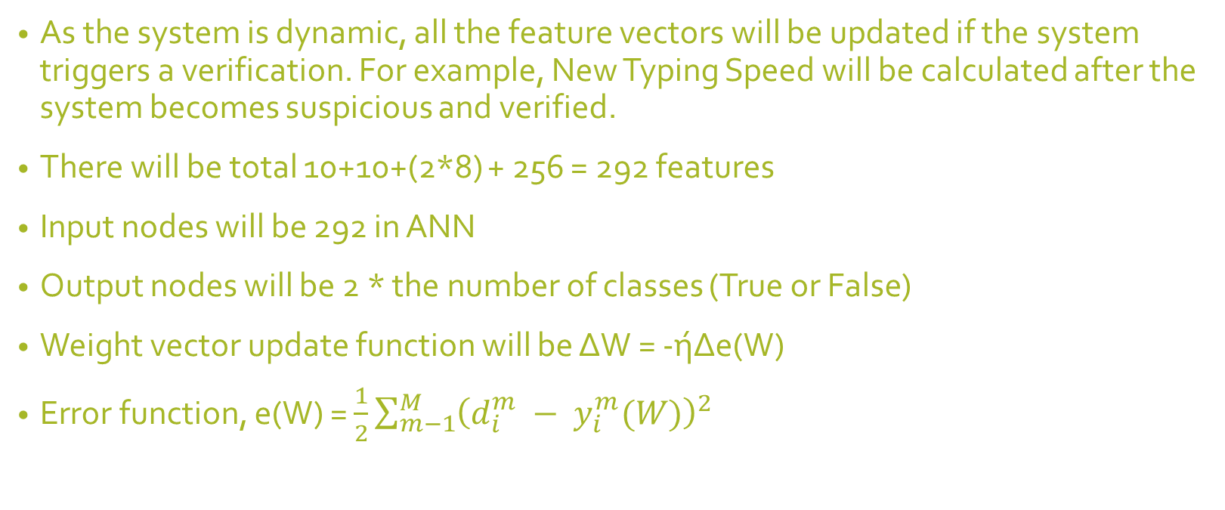
Calculation of Feature Vectors
As the system is dynamic, all the feature vectors will be updated if the system triggers a verification. For example, New Typing Speed will be calculated after the system becomes suspicious and verified.
There will be total 10+10+(2*8) + 256 = 292 features
Input nodes will be 292 in ANN
Output nodes will be 2 * the number of classes (True or False)
Weight vector update function will be ΔW = -ήΔe(W)
Error function, e(W) = $\frac{1}{2}\sum_{m−1}^{M}{{\left(d_{i}^{m} − y_{i}^{m}(W)\right)}^{2}}$

Slide 7
Hidden Layers and Learning Rate
Not sure. Need to experiment with real data

